Slide 1
A USER-FRIENDLY PRIVACY FRAMEWORK FOR USERS TO ACHIEVE CONSENTS WITH NEARBY BLE DEVICES
Binil Biju
Class No.:20 B-tech CSE
Dept of MACE, Kothamangalam
22th November 2018

Slide 2
CONTENTS
A User-Friendly Privacy Framework for Users to Achieve Consents With Nearby BLE Devices
Introduction
Background Knowledge And Related Work
Overview of the Proposed Framework
Framework Details
Proof of concept implementation
Limitations
Conclusion

Slide 3
INTRODUCTION
A User-Friendly Privacy Framework for Users to Achieve Consents With Nearby BLE Devices
Advancement in IoT technologies
IoT devices deployed around world to provide services
Many people worried about privacy risks of ubiquitous IoT devices
IoT devices may collect personal data
Notes:
hi

Slide 4
INTRODUCTION(contd...)
A User-Friendly Privacy Framework for Users to Achieve Consents With Nearby BLE Devices
Governmental agencies
Low-quality consents
IoT devices accessed via BLE from smartphone
Privacy Preferences Expression Framework - PrivacyBat
Notes:
hi

Slide 5
BACKGROUND KNOWLEDGE
A User-Friendly Privacy Framework for Users to Achieve Consents With Nearby BLE Devices
BLE security and privacy
Privacy invasion and countermeasures
Notes:
hi

Slide 6
WHAT IS BLE ?
A User-Friendly Privacy Framework for Users to Achieve Consents With Nearby BLE Devices
Bluetooth Low Energy
Managed by Bluetooth Special Interest Groups
Operates in 2.4GHz ISM band
Data send as packets
79 designated Bluetooth channels with each 1MHz in bandwidth
Range is power-class-dependent
Bluetooth 4.2

Slide 7
BLE SECURITY AND PRIVACY
A User-Friendly Privacy Framework for Users to Achieve Consents With Nearby BLE Devices
Low power communication
Communication with other device in two means
Broadcast message
Connect to other device
Pairing carried out by Security Management Protocol (SMP)
Bonding process

Slide 8
BLE SECURITY AND PRIVACY(contd..)
A User-Friendly Privacy Framework for Users to Achieve Consents With Nearby BLE Devices
Pairing schemes
Numeric comparison
Passkey entry
Out of band
Temporary key to exchange following keys
Long Term Key (LTK)
Connection Signature Resolution Key (CSRK)
Identity Resolving Key (IRK)

Slide 9
PRIVACY INVASION AND COUNTERMEASURES
A User-Friendly Privacy Framework for Users to Achieve Consents With Nearby BLE Devices
Malicious device may obtain smartphone MAC address
Random address scheme
May collect personal data from messages
Encrypt personal data

Slide 10
PRIVACY INVASION AND COUNTERMEASURES(contd…)
A User-Friendly Privacy Framework for Users to Achieve Consents With Nearby BLE Devices
Record scanning requests and replay the requests
Use counters
Not able to obtain privacy policies
Negotiation mechanisms

Slide 11
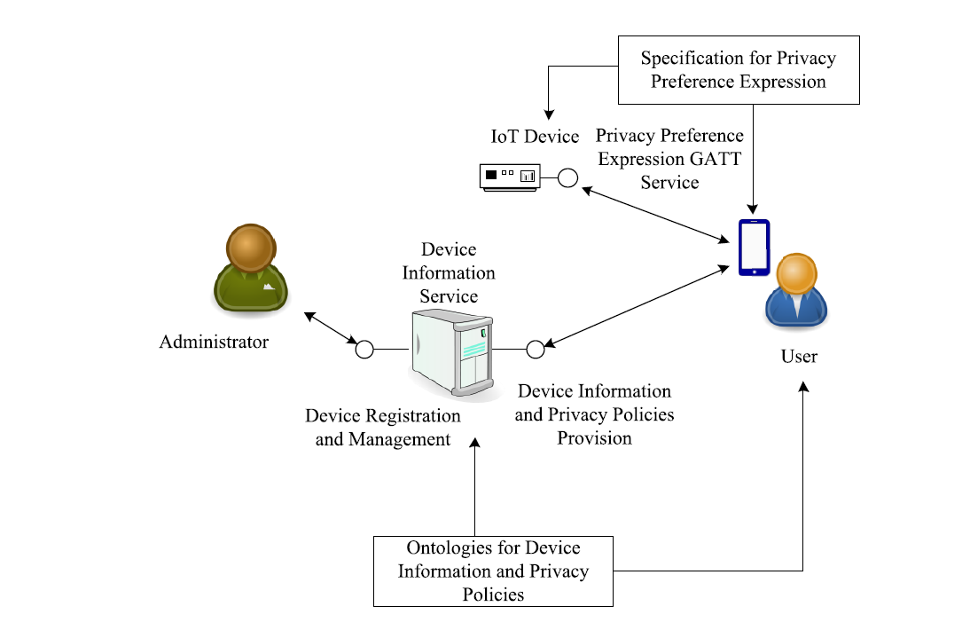
PROPOSED FRAMEWORK
A User-Friendly Privacy Framework for Users to Achieve Consents With Nearby BLE Devices
Courtesy : https://ieeexplore.ieee.org/document/8327825

Slide 12
PRIVACYBAT FRAMEWORK
A User-Friendly Privacy Framework for Users to Achieve Consents With Nearby BLE Devices
Device Information Service
Device Registration and Management
Device Information and Privacy Policy Provision

Slide 13
PRIVACYBAT FRAMEWORK(contd..)
A User-Friendly Privacy Framework for Users to Achieve Consents With Nearby BLE Devices
UPnP device schema
Attributes in UPnP device schema to describe a device
Device information format extends UPnP device schema
PolicyList attribute to store identities of the privacy policies
Defines types of Services and Characteristics for GATT service

Slide 14
PRIVACYBAT FRAMEWORK(contd..)
A User-Friendly Privacy Framework for Users to Achieve Consents With Nearby BLE Devices
Defines privacy policies based on P3P
Core of privacy policy is statements

Slide 15
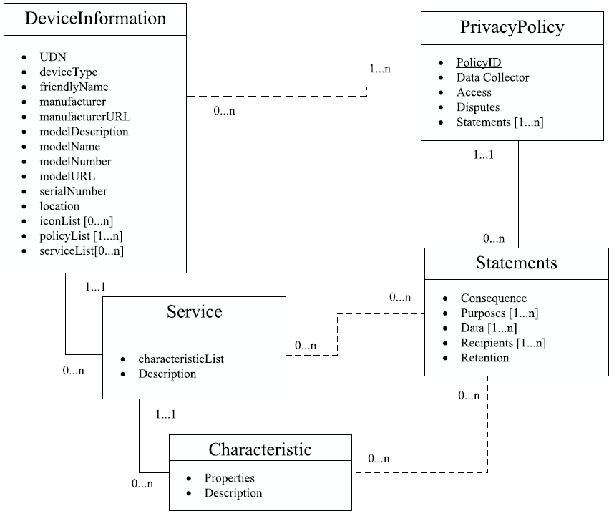
Data Schema
A User-Friendly Privacy Framework for Users to Achieve Consents With Nearby BLE Devices
Courtesy : https://ieeexplore.ieee.org/document/2827419
Courtesy : https://ieeexplore.ieee.org/document/8327825

Slide 16
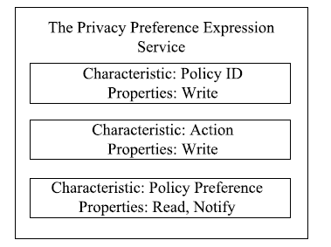
PRIVACYBAT FRAMEWORK(contd..)
A User-Friendly Privacy Framework for Users to Achieve Consents With Nearby BLE Devices
Privacy Preference Expression GATT Service
Courtesy : https://ieeexplore.ieee.org/document/8327825

Slide 17
PRIVACYBAT FRAMEWORK(contd..)
A User-Friendly Privacy Framework for Users to Achieve Consents With Nearby BLE Devices
Policy ID
For user to specify policy
Action
To specify action for the policy
Policy Preference
Exposes preference of policy

Slide 18
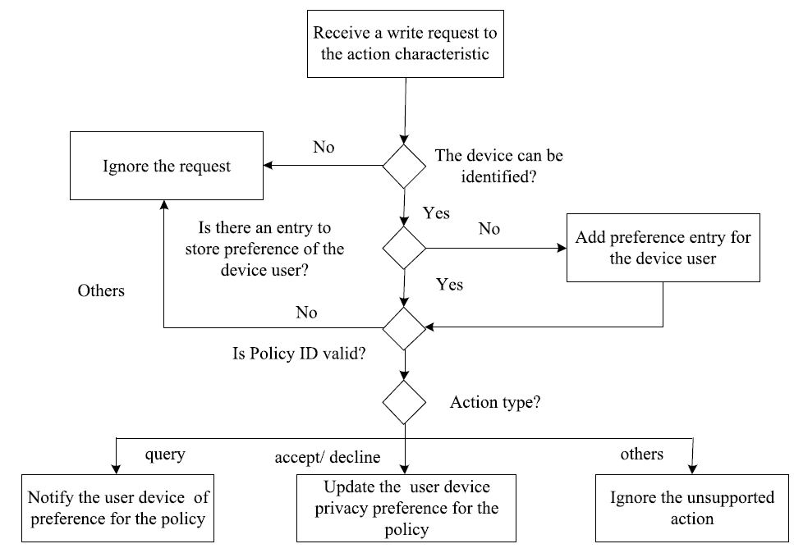
REQUEST HANDLING
A User-Friendly Privacy Framework for Users to Achieve Consents With Nearby BLE Devices
Courtesy : https://ieeexplore.ieee.org/document/8327825

Slide 19

REQUEST HANDLING(contd…)
A User-Friendly Privacy Framework for Users to Achieve Consents With Nearby BLE Devices
Starts when it receives a write request to action
Identity of user device is verified
Uses device’s real bluetooth MAC address
Each peripheral device has a table of tuples

Slide 20
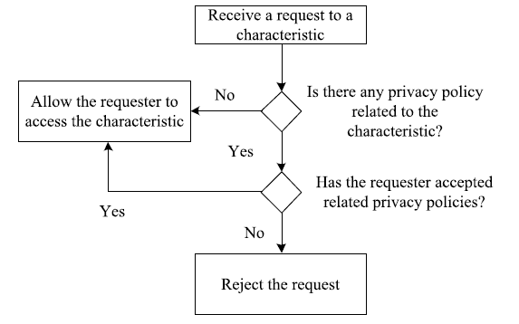
REQUEST HANDLING(contd…)
A User-Friendly Privacy Framework for Users to Achieve Consents With Nearby BLE Devices
Processing requests to normal characteristics
Courtesy : https://ieeexplore.ieee.org/document/8327825

Slide 21
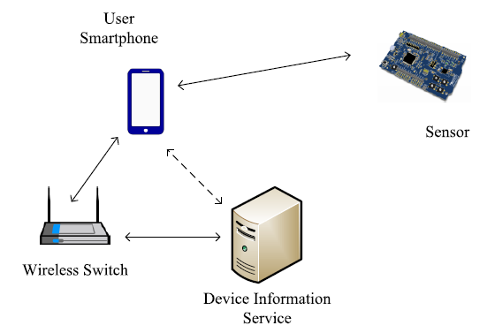
PROOF OF CONCEPT IMPLEMENTATION
A User-Friendly Privacy Framework for Users to Achieve Consents With Nearby BLE Devices
A prototype system to verify practicality
Courtesy : https://ieeexplore.ieee.org/document/8327825

Slide 22
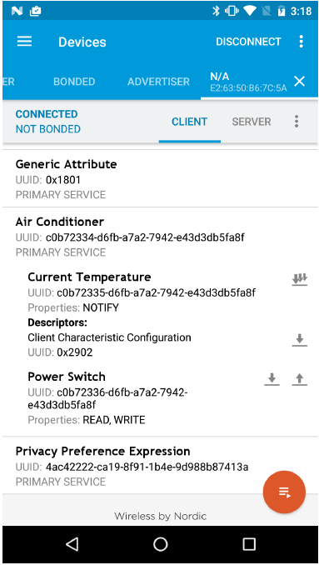
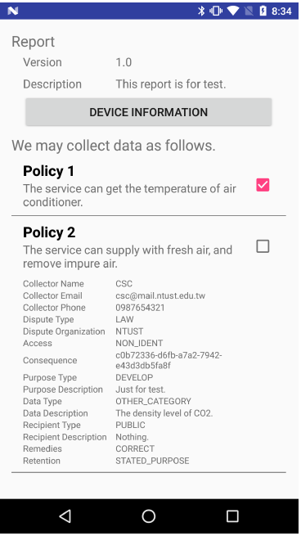
PROOF OF CONCEPT IMPLEMENTATION(contd…)
A User-Friendly Privacy Framework for Users to Achieve Consents With Nearby BLE Devices
Courtesy : https://ieeexplore.ieee.org/document/8327825

Slide 23
LIMITATIONS
A User-Friendly Privacy Framework for Users to Achieve Consents With Nearby BLE Devices
Legacy BLE devices
Gateway to connect legacy devices
Implementing gateway is challenging
User acceptance of application
To know whether a device follows privacy policies
Tools for user smartphone
IoTScanner

Slide 24
CONCLUSION
A User-Friendly Privacy Framework for Users to Achieve Consents With Nearby BLE Devices
Proposed a framework of Privacy Preferences Expression
Standard means to obtain privacy policies of nearby devices
It can be implemented with commercially available products

Slide 25
REFERENCES
A User-Friendly Privacy Framework for Users to Achieve Consents With Nearby BLE Devices
J. Groopman and S. Etlinger. (Jun. 2015). Consumer perceptions of privacy in the Internet of Things: What brands can learn from a concerned citizenry. Altimeter Group. Accessed: Feb. 9, 2018. [Online]. Available: http://www.altimetergroup.com/pdf/reports/ConsumerPerceptions-Privacy-IoT-Altimeter-Group.pdf
V. Pureswaran and P. Brody, ‘‘Device democracy: Saving the future of the Internet of Things,’’ IBM Inst. Bus. Value, Tech. Rep. GBE03620USEN, 2015, accessed: Feb. 9, 2018. [Online]. Available: https://www-935.ibm.com/services/multimedia/GBE03620USEN.pdf
EU Article 29 Data Protection Working Party, Opinion 8/2014 on the on Recent Developments on the Internet of Things, European Commission, Brussels, Belgium, 2014.
US Federal Trade Commission, The Internet of Things: Privacy and Security in a Connected World, Federal Trade Commission Staff Reports, DIANE Publishing Company, Collingdale, PA, USA, 2015.
Bluetooth Core Speciﬁcation, Bluetooth SIG, Inc., Kirkland, WA, USA, 2016.

Slide 26
REFERENCES(Contd..)
A User-Friendly Privacy Framework for Users to Achieve Consents With Nearby BLE Devices
R. Davidson, K. Townsend, C. Wang, and C. Cufí, Getting Started With Bluetooth Low Energy: Tools and Techniques for Low-Power Networking. Sebastopol, CA, USA: O’Reilly, 2014.
N. Gupta, Inside Bluetooth Low Energy. Norwood, MA, USA: Artech House, 2013, accessed: Feb. 9, 2018. [Online]. Available: https://books.google.com.tw/books?id=-LMq0NhoEQgC
M. Ryan, ‘‘Bluetooth: With low energy comes low security,’’ in Proc. 7th USENIX Workshop Offensive Technol. (WOOT), Washington, DC, USA, Aug. 2013, accessed: Feb. 9, 2018. [Online]. Available: https://www.usenix.org/system/ﬁles/conference/woot13/woot13-ryan.pdf
K. Fawaz, K.-H. Kim, and K. G. Shin, ‘‘Protecting privacy of BLE device users,’’ in Proc. 25th USENIX Secur. Symp. (USENIX Security), Austin, TX, USA, Aug. 2016, pp. 1205–1221.

Slide 27
A User-Friendly Privacy Framework for Users to Achieve Consents With Nearby BLE Devices
THANK YOU

